Slide 2
A stack of 3 tennis balls:

Slide 3
Find the circumference by wrapping, then compare the circumference with the height of the stack of three.

Slide 4

Half of a tennis ball:

Slide 5
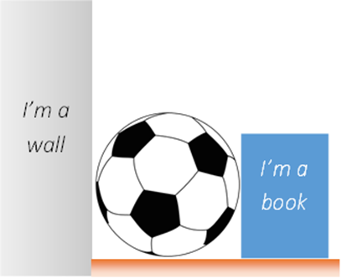
Measuring diameter of a sphere:

Slide 6
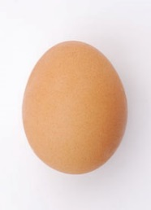
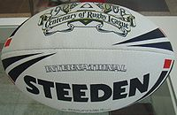
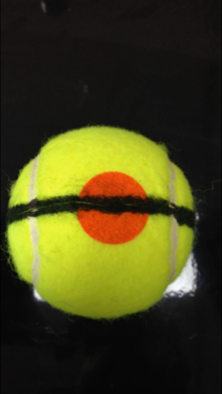
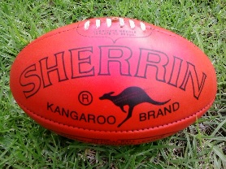
Would the relationship change if the ball was not a sphere?

